Slide 1

Networking in the Cloud

Slide 2
Understanding Network as a Service (NaaS)

Slide 3
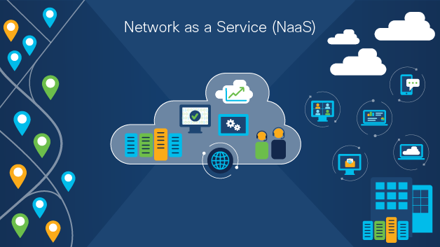
What is NaaS?
While the detailed definition of Network as a Service (NaaS) is still up for debate, everyone agrees that in principle, it represents a shift from traditional network management to a subscription-based model that offers network services on-demand. This approach abstracts the complexities of network configuration, maintenance, and management, allowing enterprises to focus on their core competencies rather than the intricacies of networking. By leveraging a cloud-based platform, NaaS provides a suite of services including virtual private networks (VPNs), bandwidth on demand, and network security services. This model empowers businesses to adapt quickly to changing technological landscapes without the need for extensive in-house expertise or infrastructure investment.

Slide 4
What is NaaS?
The flexibility of NaaS is one of its defining characteristics, enabling businesses to tailor their network resources to fit specific needs. This adaptability translates to improved operational efficiency and the ability to respond swiftly to market changes. Additionally, by shifting from capital expenditures to operational expenditures, companies can better manage their budgets, ensuring that resources are allocated more effectively. With NaaS, enterprises no longer need to worry about the obsolescence of technology or the complexities of managing multiple network vendors, as everything is streamlined through a single service provider.

Slide 5
How Does NaaS Work?
Through a cloud-based platform, Network as a Service (NaaS) provides organizations with internet access to networking resources, this is the way NaaS typically works:
Cloud-Based Platform:
NaaS is conveyed through a cloud-based platform managed by a service provider. Organizations buy into the NaaS platform and access networking services through online portals, APIs, or command-line interfaces (CLIs),
Centralized Management:
Organizations can monitor and manage their network infrastructure from a single dashboard to centralized management interfaces provided by NaaS platforms. Administrators can see network execution measurements, break down traffic design, troubleshoot issues, and make configuration changes as needs be.

Slide 6
How Does NaaS Work?
Security and Compliance: Network infrastructure and data are protected from unauthorized access, data breaches, and other security threats by NaaS platforms' extensive security measures. They additionally offer consistence confirmations and adherence to industry principles to ensure data privacy, respectability, and accessibility.
On-Demand Provisioning:
With NaaS, organizations can provision networking resources on-request as per their particular prerequisites, through the self-service interfaces of the NaaS platform, they can set up virtual networks, define routing policies, set security setting, and deploy other networking components as needed.

Slide 7
How Does NaaS Work?
Pay-Per-Use Billing:
Pay-per-use billing is typically used by NaaS providers, with organizations being charged based on how much they actually use networking services, this utilization based estimating model offers cost effectiveness and adaptability, as associations just compensation for the resources they consume, as opposed to putting resources into excess limit.
Scalability and Flexibility:
Organizations can dynamically scale their network infrastructure in response to shifting demand with NaaS. They can add or remove virtual networking components, adjust configurations, and allocate resources depending on the situation to support business development, seasonal fluctuations, or new initiative.

Slide 8
How Does NaaS Work?
Virtualization of Networking Components:
NaaS use virtualization technologies to abstract conventional networking components parts like routers, switches, firewalls, and load balancers from the basic actual equipment. These parts are virtualized and provisioned as software-based instances in the cloud.

Slide 9
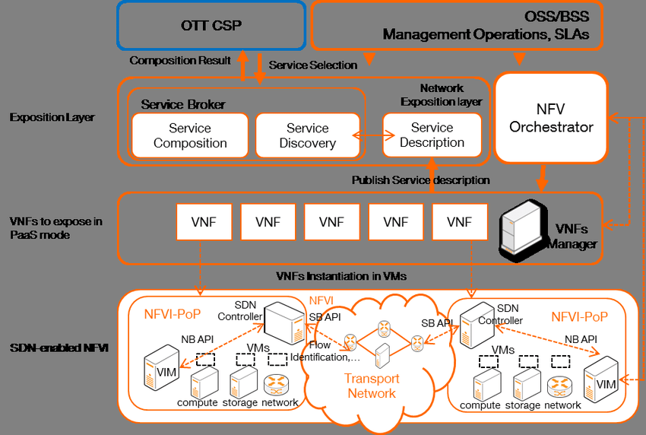

Slide 10
What are the types of Network as a Service resources?
Network as a Service (NaaS) offers an extensive variety of networking resources that organizations can access and use over the internet. Some of the key types of NaaS resources include:
Virtual Networks
Virtual Networks allows organizations to establish isolated network conditions in the cloud, complete with virtual subnets, IP addresses, and routing tables. These virtual networks empower secure communication between various applications, users, and services while maintaining logical separation.

Slide 11
What are the types of Network as a Service resources?
Routers and Switches
NaaS platforms give virtual routers and switches that work with the routing and switching of network traffic inside virtualized conditions, these product based routing and switching parts empower associations to define and manage network traffic streams, carry out routing policies, and ensure proficient data transmission.
Load Balancers
NaaS platform offer virtual load-balancers that appropriate approaching organization traffic across numerous servers or resources to enhance execution, unwavering quality, and accessibility, these load balancers help equitably convey responsibilities, prevent over-load of individual resources, and ensure a smooth and steady user experience.

Slide 12
What are the types of Network as a Service resources?
VPN (Virtual Private Network)
Virtual private networks given by NaaS platform empower secure correspondence and data exchange between remote users, branch offices, and cloud-based resources, VPNs encrypt network traffic, verify users, and lay out private and secure associations over open network like the internet.
Firewalls
Virtual firewalls presented as a component of NaaS arrangements allow organizations to support security policies and control access to network resources. These firewalls review incoming and active traffic, block unapproved access endeavors, and provide interruption detection and prevention abilities to protect against cyber threats.

Slide 13
SD-WAN (Software-Defined Wide Area Network)
SD-WAN arrangements presented as a component of NaaS empower associations to improve and manage network across distributed areas. SD-WAN advances use software defined networking standards to powerfully route traffic over different network paths, further develop application execution, and decrease latency and data transfer capacity costs.

Slide 14
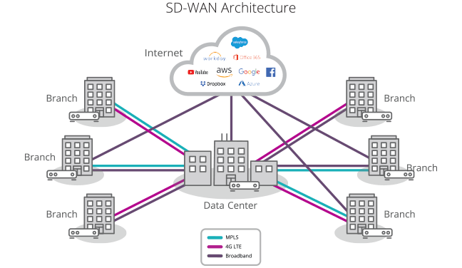

Slide 15
Advantages of Network as a Service (NaaS)
Scalability:
Businesses can easily up or down their network infrastructure using NaaS, depending on their requirements, businesses that are experiencing rapid growth or have varying demands especially benefit from this flexibility.
Cost-Efficiency:
Businesses can save a lot of money upfront by using NaaS, which typically operates on a subscription or pay-per-use model, because businesses only pay for the services they use, this also makes it easier to predict costs.

Slide 16
Advantages of Network as a Service (NaaS)
Accessibility:
NaaS makes network resources accessible from anywhere with an internet connection, making it possible to work remotely and for teams with different locations to work together.
Reliability:
Service level agreements (SLAs) that ensures a certain level of uptime and performance are provided by many NaaS providers. Businesses that heavily rely on their network infrastructure for critical operations may particularly benefit from this.

Slide 17
Advantages of Network as a Service (NaaS)
Rapid deployment:
Businesses can quickly adapt to new requirements or market conditions adapt to the rapid deployment of NaaS solutions. In today's fast-paced business environment, this agility is essential.
Global Reach:
NaaS providers often have a global presence, businesses can easily expand their network's reach to new locations without making significant infrastructure investment.

Slide 18
Advantages of Network as a Service (NaaS)
Improved efficiency:
High-performance connectivity is typically provided by NaaS providers through the use of cutting-edge networking infrastructure and technologies, ensuring the best possible user experience for essential applications and services
Compliance:
When it comes to data protection and privacy, NaaS providers assist businesses by adhering to industry standards and regulations.

Slide 19
Disadvantages of Network as a Service (NaaS)
Vendor Lock-In:
Adopting NaaS solutions from a single service provider may result in vendor lock-in, making it difficult or costly for businesses to switch providers or return to in-house network management. Organizations that lack flexibility may be unable to take advantage of emerging technologies or adapt to shifting business requirements.
Reliability and Availability:
NaaS solutions may still experience downtime due to network issues, maintenance activities, or failures in the service provider's infrastructure, despite the promises of high availability and redundancy. To reduce the likelihood of disruptions to their operations, businesses must evaluate the provider's reliability and availability history.

Slide 20
Disadvantages of Network as a Service (NaaS)
Dependency on Service Providers:
Businesses are dependent on the provider's dependability, uptime, and quality of service when they rely on a third-party service provider for their network infrastructure, operations could be disrupted if the service provider has any issues.
Data Security Concerns:
Concerns about data privacy and security arise when sensitive data are entrusted to a third-party service providers. To ensure the safety of their data, businesses must carefully evaluate the security measures taken by NaaS providers.

Slide 21
Disadvantages of Network as a Service (NaaS)
Potential Performance Issues:
Limitations on bandwidth, latency, and congestion can have an impact on network performance, which can vary depending on the service provider and the underlying infrastructure, the NaaS solution's performance should be evaluated to see if it meets the needs of requirements
Limited Control:
With NaaS, organizations relinquish a level of control over their network infrastructure to the service provider. Concerns regarding customization, configuration, and troubleshooting may result from this lack of control, particularly for businesses with particular network requirements

Slide 22
Disadvantages of Network as a Service (NaaS)
Integration Challenges:
If the NaaS solution does not seamlessly integrate with other technologies utilized by the business, it can be difficult to integrate NaaS with existing IT systems, applications, and workflows. Compatibility issues may arise, necessitating additional integration efforts and resources.

Slide 23
Naas Providers who are providing NaaS cloud computing platform
PROVIDER | DESCRIPTION
Amazon Web Services (AWS) | AWS offers various networking services like Virtual Private Cloud (VPC), AWS Transit Gateway, and AWS Global Accelerator to provide networking solutions
Google Cloud Platform (GCP) | GCP offers various networking services like Cloud VPN, Cloud Load Balancing and Virtual Private Cloud (VPC) to create global networks
Microsoft Azure | Azure provides networking services like Azure Virtual Network, Azure VPN Gateway, Azure Express Route and Azure Load Balancer to build secure and High-permanence networks in cloud
IBM Cloud | IBM Cloud provides networking services like VPC, IBM Cloud Load Balancer and IBM Cloud VPN offering to secure and reliable networks options in cloud
Oracle Cloud Infrastructure (OCI) | OCI offers networking services like VCN that is Virtual Cloud Network, VPN Connect, FastConnect and load balancing these are enabling high available and scalable networks in the cloud.
Cisco SD-WAN | Cisco offers SD-WAN solutions this was provide secure connection.
Juniper Contrail SD-WAN | Juniper Network offers contrail SD-WAN this provide automated networking and security to simply network infrastructure.

Slide 24
The Intersection of NaaS and Cloud Security
As enterprises increasingly migrate their operations to the cloud, the security of these cloud environments becomes paramount. The integration of NaaS with cloud security measures provides a robust framework for safeguarding data, applications, and networks against cyber threats. This involves a comprehensive array of security protocols, including encryption, identity and access management (IAM), and threat detection and response. By embedding these measures into the NaaS model, businesses can ensure that their digital assets are protected from unauthorized access and breaches.

Slide 25
The Intersection of NaaS and Cloud Security
Cloud security within the context of NaaS is not just about protecting data, but also about maintaining the integrity and availability of services. As businesses rely more on cloud-based platforms, ensuring continuity and resilience becomes essential. NaaS providers incorporate advanced security features to detect and mitigate potential threats proactively, minimizing downtime and maintaining business operations. This holistic approach to security is essential for building trust with customers and stakeholders, as well as for complying with industry regulations and standards.

Slide 26
Integration of Security in NaaS
The integration of cloud security in NaaS is not merely an add-on but a core component. Security policies and protocols are embedded into the network services, ensuring that data remains protected as it traverses through the cloud. This integrated approach enhances the overall security posture of the enterprise by providing end-to-end protection. By embedding security into the very fabric of the network, NaaS ensures that all data and applications are secured at every stage of their lifecycle.

Slide 27
Integration of Security in NaaS
This security integration also allows for more seamless management of security policies across the entire network. Enterprises can implement consistent security measures across all endpoints, reducing the risk of vulnerabilities. Moreover, NaaS providers often offer advanced analytics and monitoring tools that provide real-time insights into network performance and security threats. These tools empower businesses to take a proactive approach to security, addressing potential issues before they escalate into major incidents.

Slide 28
SD-WAN: A Crucial Component of NaaS
Software-Defined Wide Area Network (SD-WAN) is a critical technology within the NaaS framework. It decouples the network control plane from the physical hardware, enabling more efficient and flexible network management. This separation allows enterprises to manage their network through software, providing greater control over how data is routed and prioritized. SD-WAN optimizes the performance of applications hosted in on-premises data centers, public or private clouds, and SaaS services by dynamically routing traffic across the most efficient path.

Slide 29
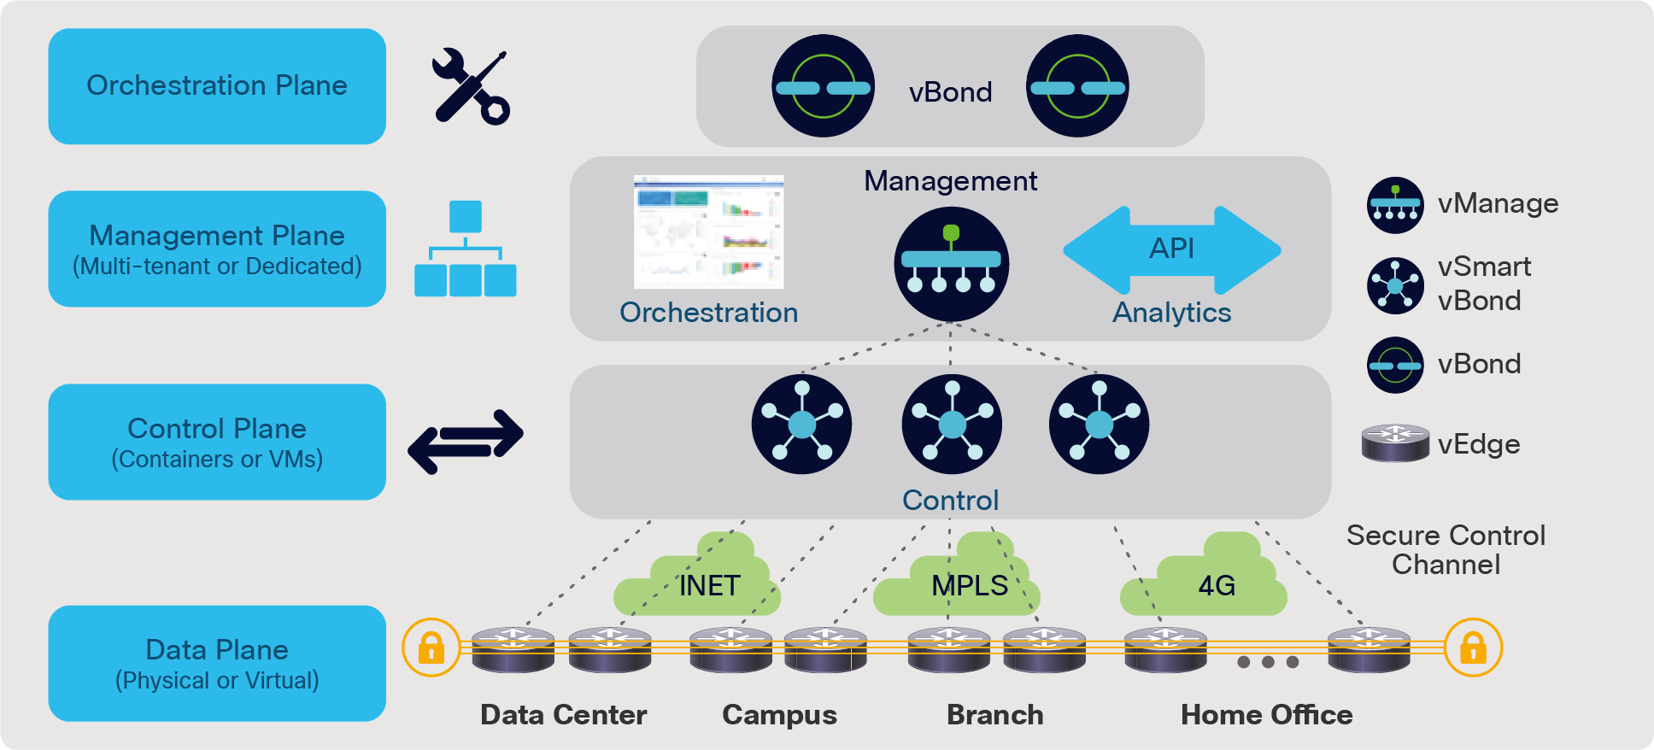

Slide 30
SD-WAN: A Crucial Component of NaaS
SD-WAN's ability to adapt to real-time network conditions means that businesses can ensure optimal application performance, regardless of location or network load. This technology not only enhances user experience but also supports business continuity by minimizing the risk of outages and disruptions. Additionally, by leveraging broadband internet connections instead of costly MPLS circuits, SD-WAN can significantly reduce operational costs, making it an attractive option for enterprises looking to optimize their network spending.

Slide 31
Benefits of SD-WAN in NaaS
Improved Performance:
SD-WAN ensures optimal application performance by intelligently routing traffic based on real-time network conditions. This capability is particularly beneficial for businesses that rely on cloud-based applications, as it ensures that users have a seamless experience regardless of their location. By prioritizing critical applications and dynamically adjusting bandwidth allocation, SD-WAN helps maintain high levels of productivity and efficiency.

Slide 32
Benefits of SD-WAN in NaaS
Enhanced Security:
By integrating security features such as encryption and secure tunneling, SD-WAN provides a robust security layer for network traffic. This integration ensures that data is protected as it moves across the network, reducing the risk of interception or unauthorized access. Additionally, SD-WAN's centralized management capabilities allow for more consistent enforcement of security policies, further strengthening the network's security posture.

Slide 33
Benefits of SD-WAN in NaaS
Cost Savings:
SD-WAN reduces the dependency on expensive MPLS circuits by leveraging cost-effective broadband connections. This shift not only lowers operational costs but also provides greater flexibility in terms of network configuration and management. By reducing reliance on traditional networking infrastructure, businesses can allocate resources more efficiently, investing in areas that drive innovation and growth.

Slide 34
SASE: The Future of Secure Networking
Secure Access Service Edge (SASE) is an emerging framework that combines network security functions with WAN capabilities to support the dynamic secure access needs of modern enterprises. SASE converges multiple security and networking technologies into a unified, cloud-native service. This convergence simplifies the management of network and security services, providing a more streamlined approach to ensuring secure connectivity.

Slide 35
SASE: The Future of Secure Networking
By integrating networking and security into a single platform, SASE offers a more holistic approach to managing enterprise networks. This approach not only enhances security but also improves network performance and reliability. As businesses continue to embrace remote work and digital transformation, SASE provides the flexibility and scalability needed to support these initiatives. Furthermore, by delivering security and networking services from the cloud, SASE reduces the complexity and cost associated with traditional on-premises solutions.

Slide 36
Core Components of SASE
Zero Trust Network Access (ZTNA):
Ensures that access to network resources is granted based on strict identity verification. This principle minimizes the risk of unauthorized access by implementing a "never trust, always verify" approach. ZTNA is particularly important in today's remote work environment, where employees access corporate resources from various locations and devices.
Secure Web Gateway (SWG):
Protects users from web-based threats by enforcing security policies. SWG acts as a barrier between users and potential online threats, filtering out malicious content and blocking access to harmful websites. This protection is essential for safeguarding sensitive information and maintaining compliance with industry regulations.

Slide 37
Core Components of SASE
Cloud Access Security Broker (CASB):
Provides visibility and control over data and applications in the cloud. CASB acts as an intermediary between users and cloud service providers, ensuring that data is transferred securely and that compliance policies are enforced. This visibility is crucial for detecting and mitigating potential security risks associated with cloud services.
Firewall as a Service (FWaaS):
Delivers firewall capabilities as a cloud service, ensuring consistent security policies across all network edges. FWaaS provides a centralized approach to managing firewall rules and policies, making it easier to protect against threats and ensure compliance. By delivering these capabilities from the cloud, FWaaS reduces the complexity and cost of managing traditional on-premises firewalls.

Slide 38
The Role of SASE in NaaS
SASE enhances the NaaS model by providing a holistic and integrated approach to security and networking. It ensures that security policies are consistently applied across all network edges, whether they are on-premises, in the cloud, or at remote locations. This consistency is critical for maintaining a strong security posture and ensuring that all users and devices are protected, regardless of their location or the network they are using.
The integration of SASE into the NaaS framework also simplifies the management of network and security services. By consolidating these functions into a single platform, businesses can reduce the complexity and cost associated with managing multiple solutions. This consolidation not only improves efficiency but also enhances visibility and control over the network, enabling businesses to respond more effectively to emerging threats and challenges.

Slide 39
Implementing NaaS: Challenges and Considerations
While NaaS offers numerous benefits, its implementation is not without challenges. Enterprises must consider several factors to ensure a successful transition to a NaaS model. These factors include:
Service Quality and Flexibility:
While the consolidation of all network services drastically reduces complexity, it is essential to prioritize the quality and flexibility of services. Thorough vendor evaluation and SLA comparisons as well as the assessment of a provider's ability to tailor their solution to specific business needs are recommended. In the end, a provider with happy customers, guaranteed end-to-end SLAs and a designated account team that can consult and cater for custom requirements reduces the risk of a vendor lock-in.

Slide 40
Implementing NaaS: Challenges and Considerations
Integration with Existing Infrastructure:
Seamlessly integrating NaaS with existing network infrastructure and security protocols can be complex. Enterprises need to carefully assess their current environment and work closely with their chosen provider to ensure a smooth transition. This may involve updating legacy systems or implementing new technologies to support the NaaS model.
Compliance:
Ensuring compliance with industry regulations and standards is critical, particularly when sensitive data is involved. Businesses must ensure that their NaaS provider adheres to relevant compliance requirements and has robust data protection measures in place. This is particularly important for industries with strict regulatory requirements, such as healthcare and finance.

Slide 41
Best Practices for Successful NaaS Implementation
Thorough Vendor Evaluation:
Assess potential NaaS providers based on their service quality, security capabilities, and track record. This evaluation should consider factors such as customer support, performance, scalability, and pricing. By conducting a comprehensive assessment, businesses can select a provider that aligns with their strategic goals and operational requirements.
Pilot Testing:
Conduct pilot tests to evaluate the performance, support and staff expertise of the NaaS service . Pilot testing allows businesses to identify potential issues and make necessary adjustments before full-scale implementation. This approach helps minimize disruption and ensures a smoother transition to the NaaS model.

Slide 42
Best Practices for Successful NaaS Implementation
Comprehensive Security Strategy:
Develop a comprehensive security strategy that integrates NaaS with broader cybersecurity measures to protect your digital assets. This strategy should include regular security assessments, employee training, and incident response planning. By taking a proactive approach to security, businesses can better protect their networks and data from emerging threats.

Slide 43
Thank You !!!

